Slide 1
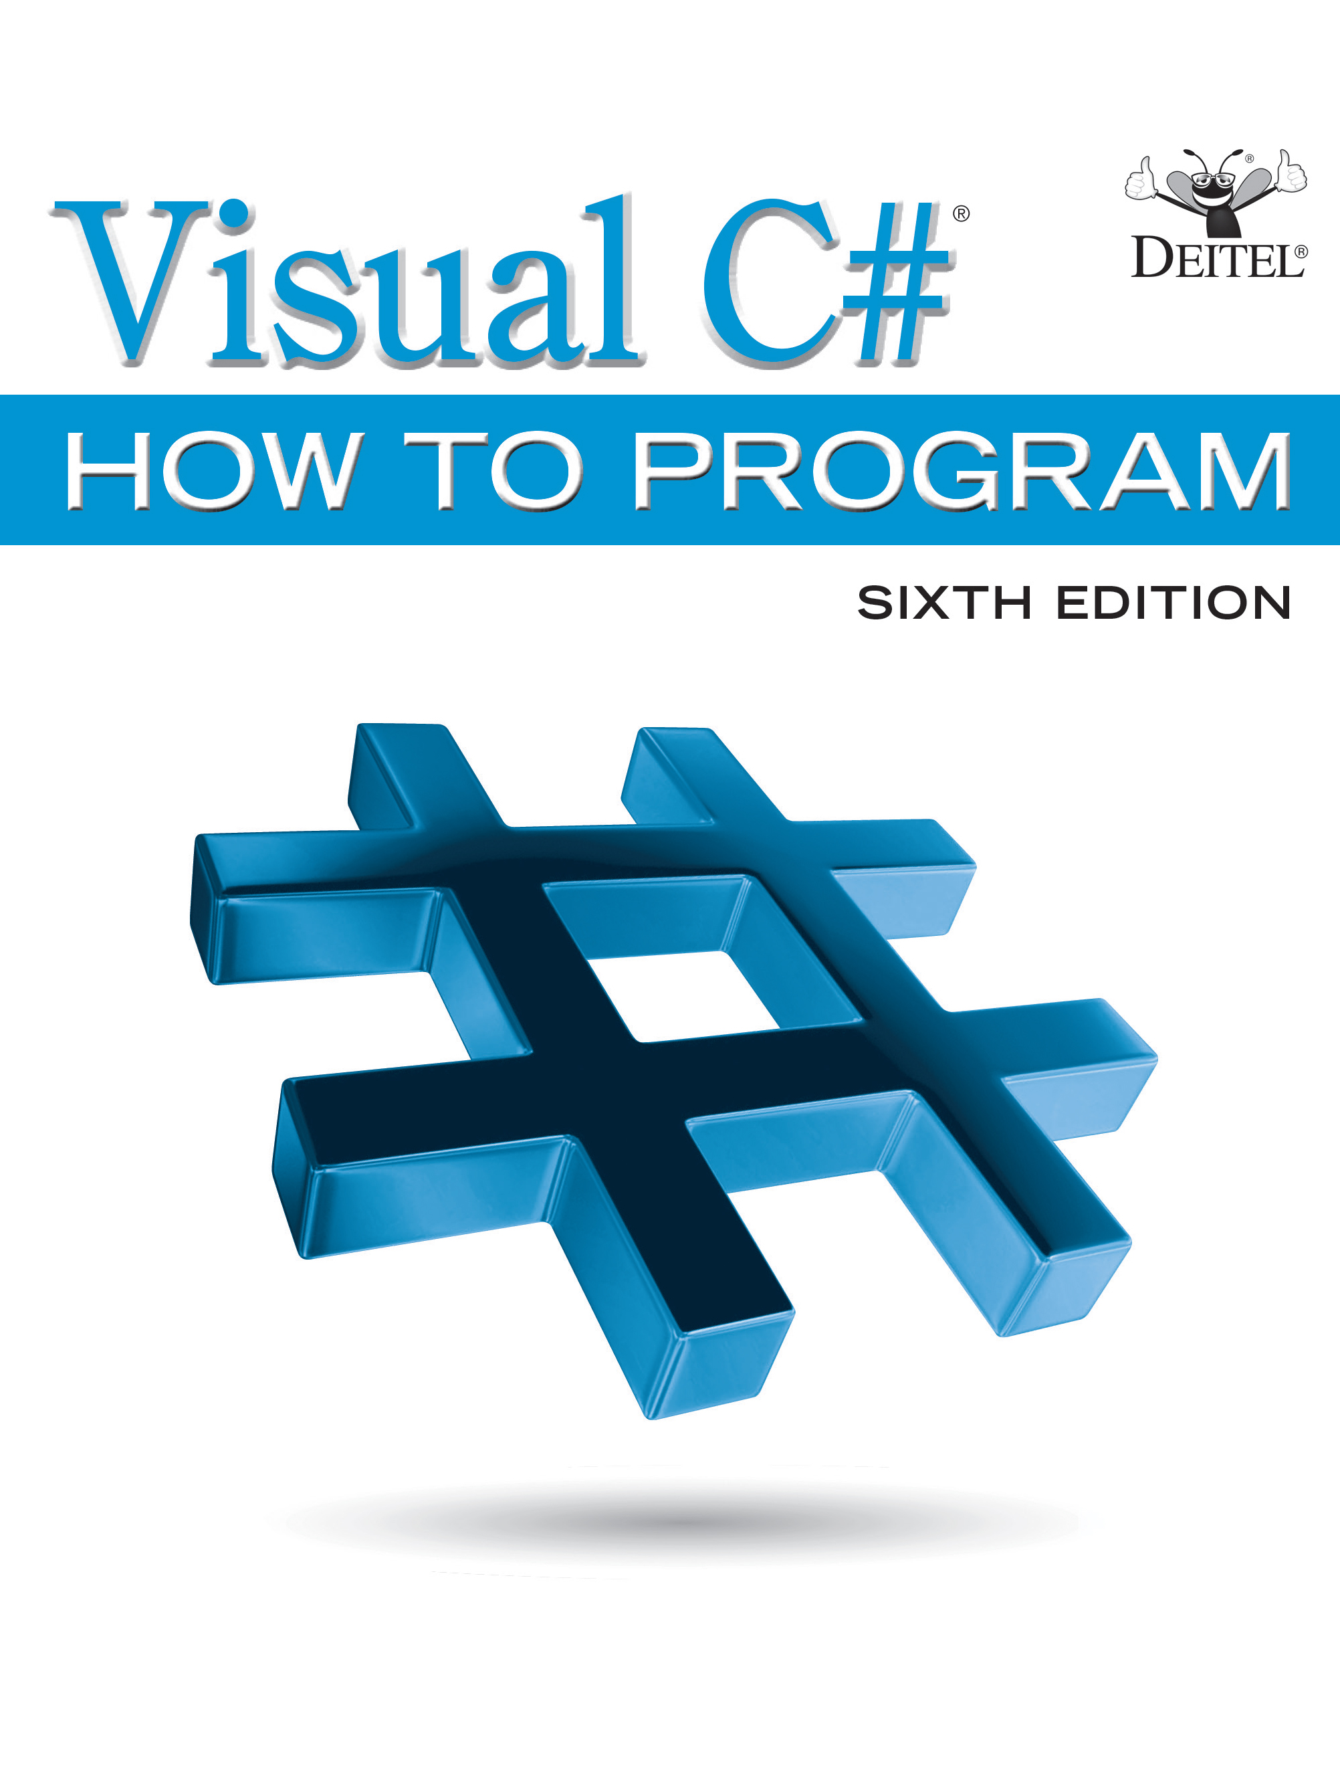
Visual C sharp® How to Program
Sixth Edition
Chapter 23
Asynchronous Programming With Async and Await
Copyright © 2017 Pearson Education, Inc. All Rights Reserved
Notes:
If this PowerPoint presentation contains mathematical equations, you may need to check that your computer has the following installed:
1) MathType Plugin
2) Math Player (free versions available)
3) NVDA Reader (free versions available)

Slide 2
Learning Objectives (1 of 2)
Understand what asynchronous programming is and how it can improve the performance of your apps.
Use the async modifier to indicate that a method is asynchronous.
Use an await expression to wait for an asynchronous task to complete execution so that an async method can continue its execution.
Take advantage of multicore processors by executing tasks asynchronously via Task Parallel Library (T P L) features.

Slide 3
Learning Objectives (2 of 2)
Use Task method WhenAll to wait for multiple tasks to complete before an async method continues.
Time multiple tasks running on a single-core system and a dual-core system (all with the same processor speeds) to determine the performance improvement when these tasks are run on the dual-core system.
Use an H t t p Client to invoke a web service asynchronously.
Show an asynchronous task’s progress and intermediate results,

Slide 4
Outline (1 of 3)
23.1 Introduction
23.2 Basics of async and await
23.2.1 async Modifier
23.2.2 await Expression
23.2.3 async, await and Threads
23.3 Executing an Asynchronous Task from a G U I App
23.3.1 Performing a Task Asynchronously
23.3.2 Method calculateButton_Click
23.3.3 Task Method Run: Executing Asynchronously in a Separate Thread
23.3.4 awaiting the Result
23.3.5 Calculating the Next Fibonacci Value Synchronously

Slide 5
Outline (2 of 3)
23.4 Sequential Execution of Two Compute-Intensive Tasks
23.5 Asynchronous Execution of Two Compute-Intensive Tasks
23.5.1 awaiting Multiple Tasks with Task Method WhenAll
23.5.2 Method StartFibonacci
23.5.3 Modifying a G U I from a Separate Thread
23.5.4 awaiting One of Several Tasks with Task Method WhenAny
23.6 Invoking a Flickr Web Service Asynchronously with HttpClient
23.6.1 Using Class HttpClient to Invoke a Web Service
23.6.2 Invoking the Flickr Web Service’s flickr.photos.search Method

Slide 6
Outline (3 of 3)
23.6.3 Processing the X M L Response
23.6.4 Binding the Photo Titles to the ListBox
23.6.5 Asynchronously Downloading an Image’s Bytes
23.7 Displaying an Asynchronous Task’s Progress
23.8 Wrap-Up

Slide 7
Performance Tip 23.1
A problem with single-threaded applications that can lead to poor responsiveness is that lengthy activities must complete before others can begin. In a multithreaded application, threads can be distributed across multiple cores (if available) so that multiple tasks execute in parallel and the application can operate more efficiently. Multithreading can also increase performance on single-processor systems—when one thread cannot proceed (because, for example, it’s waiting for the result of an I/O operation), another can use the processor.

Slide 8
Software Engineering Observation 23.1
The mechanisms for determining whether to return control to an async method’s caller or continue executing an async method, and for continuing an async method’s execution when the asynchronous task completes, are handled entirely by code that’s written for you by the compiler.

Slide 9
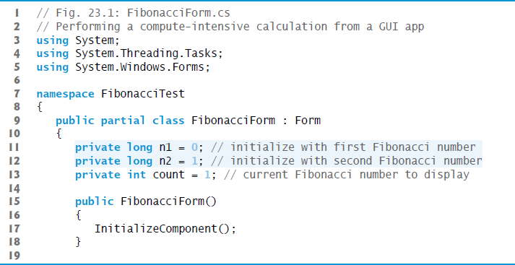
Figure 23.1 Performing a Compute-Intensive Calculation from a G U I App (1 of 6)

Slide 10
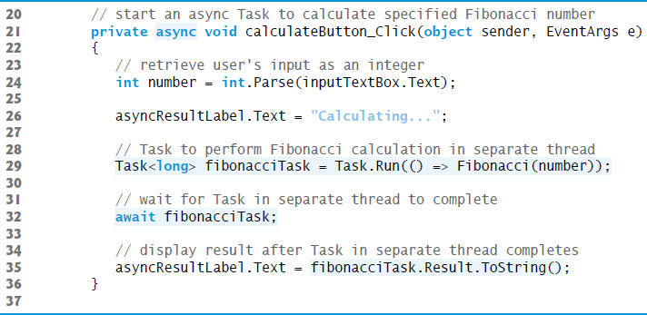
Figure 23.1 Performing a Compute-Intensive Calculation from a G U I App (2 of 6)

Slide 11
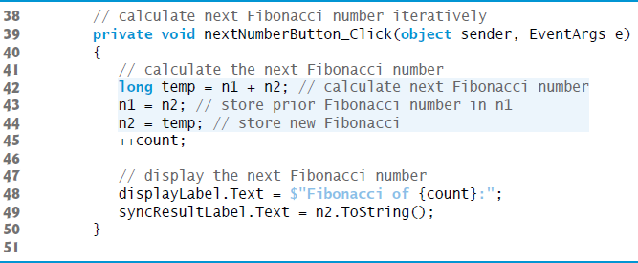
Figure 23.1 Performing a Compute-Intensive Calculation from a G U I App (3 of 6)

Slide 12
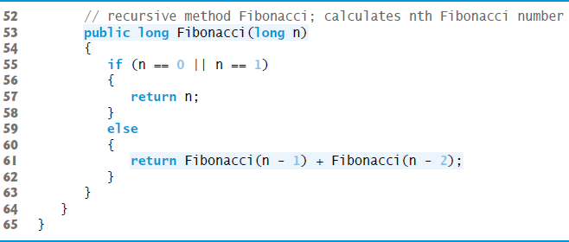
Figure 23.1 Performing a Compute-Intensive Calculation from a G U I App (4 of 6)

Slide 13
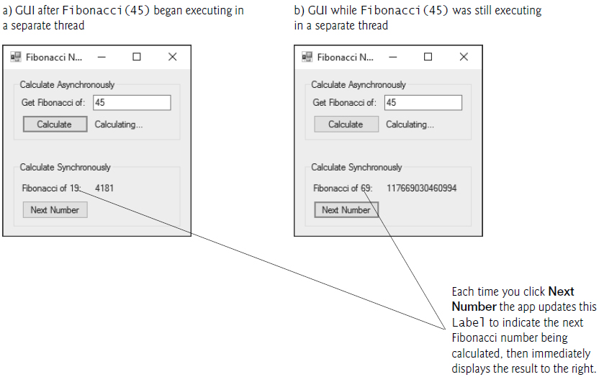
Figure 23.1 Performing a Compute-Intensive Calculation from a G U I App (5 of 6)

Slide 14
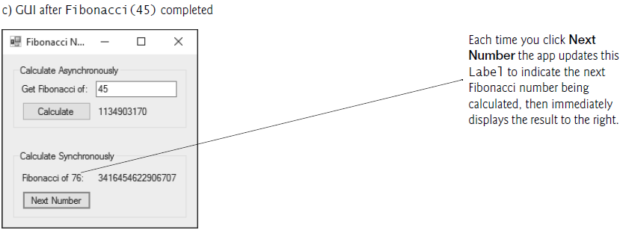
Figure 23.1 Performing a Compute-Intensive Calculation from a G U I App (6 of 6)

Slide 15
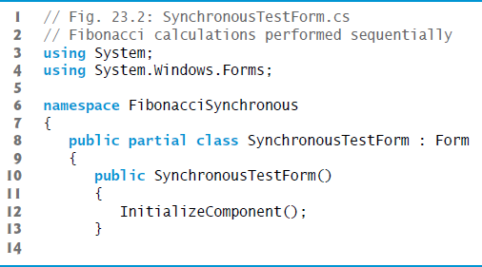
Figure 23.2 Fibonacci Calculations Performed Sequentially (1 of 6)

Slide 16
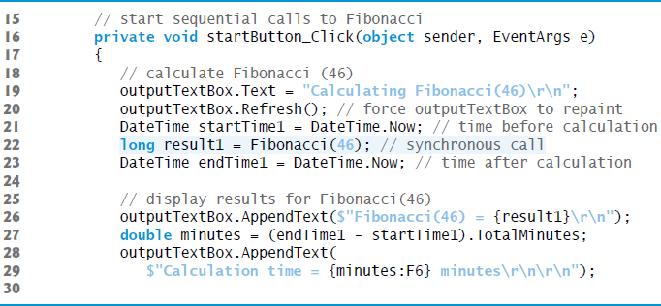
Figure 23.2 Fibonacci Calculations Performed Sequentially (2 of 6)

Slide 17
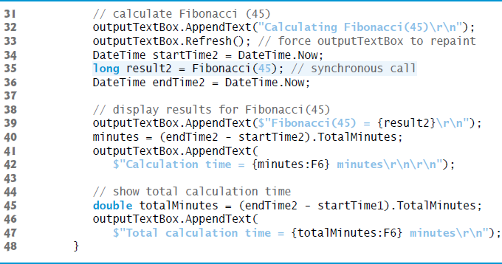
Figure 23.2 Fibonacci Calculations Performed Sequentially (3 of 6)

Slide 18
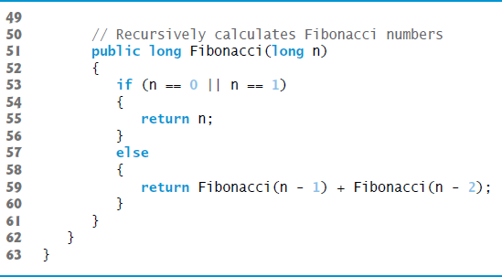
Figure 23.2 Fibonacci Calculations Performed Sequentially (4 of 6)

Slide 19
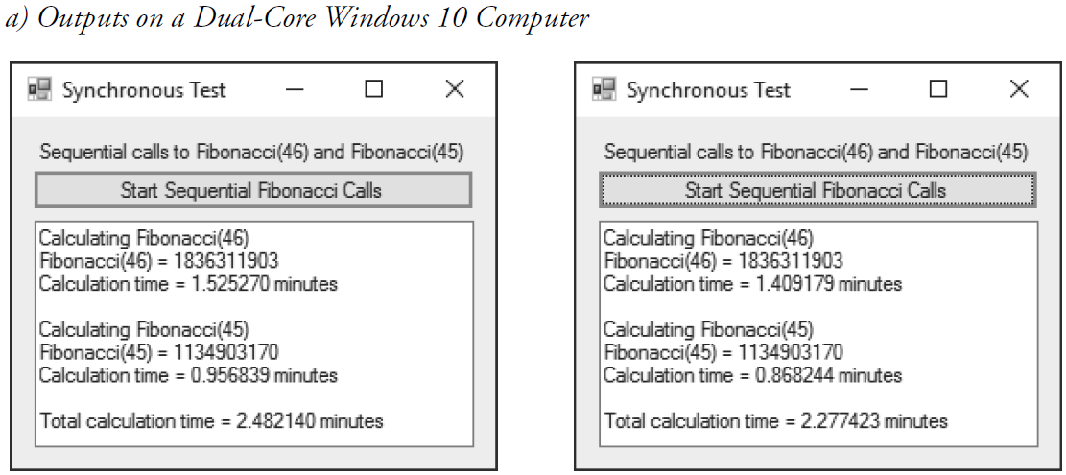
Figure 23.2 Fibonacci Calculations Performed Sequentially (5 of 6)

Slide 20
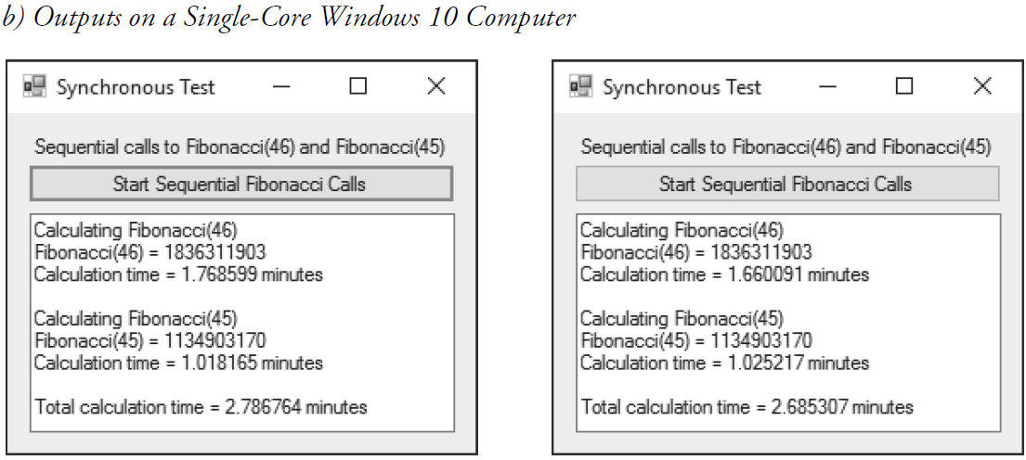
Figure 23.2 Fibonacci Calculations Performed Sequentially (6 of 6)

Slide 21
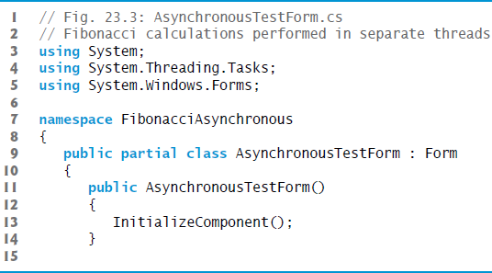
Figure 23.3 Fibonacci Calculations Performed in Separate Threads (1 of 8)

Slide 22
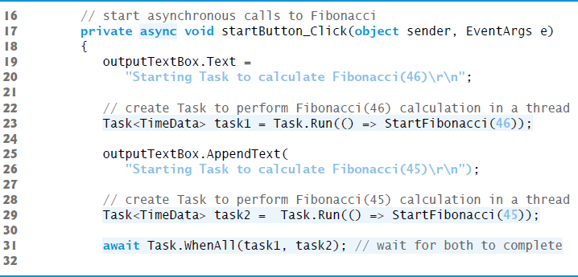
Figure 23.3 Fibonacci Calculations Performed in Separate Threads (2 of 8)

Slide 23
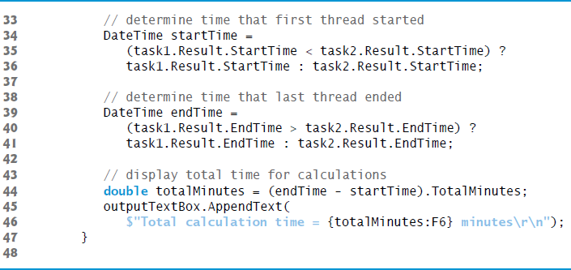
Figure 23.3 Fibonacci Calculations Performed in Separate Threads (3 of 8)

Slide 24
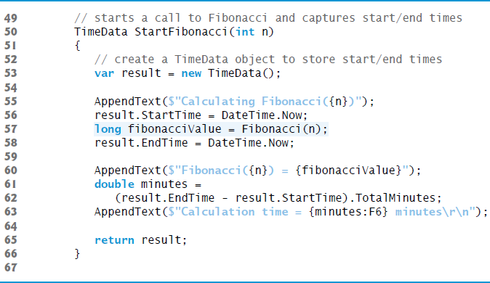
Figure 23.3 Fibonacci Calculations Performed in Separate Threads (4 of 8)

Slide 25
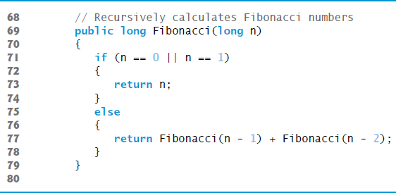
Figure 23.3 Fibonacci Calculations Performed in Separate Threads (5 of 8)

Slide 26
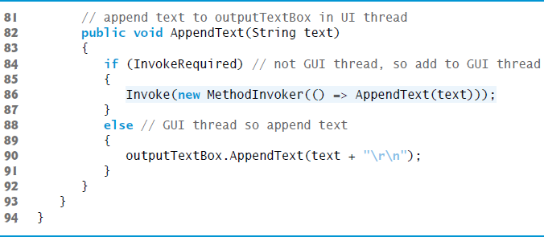
Figure 23.3 Fibonacci Calculations Performed in Separate Threads (6 of 8)

Slide 27
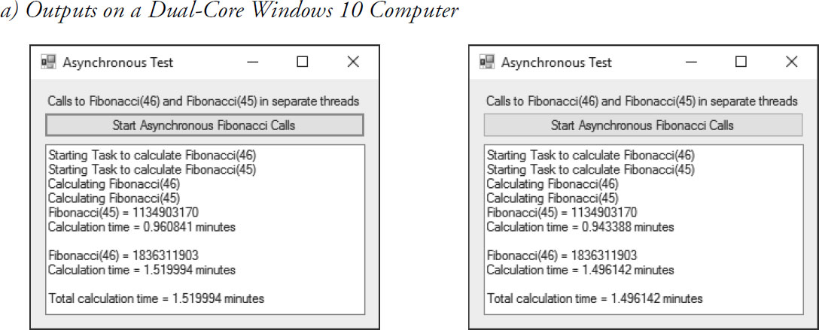
Figure 23.3 Fibonacci Calculations Performed in Separate Threads (7 of 8)

Slide 28
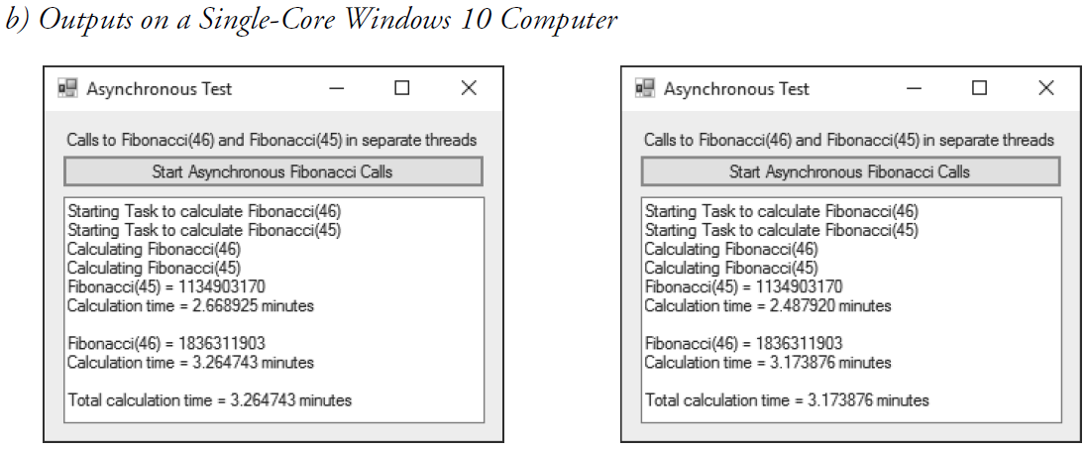
Figure 23.3 Fibonacci Calculations Performed in Separate Threads (8 of 8)

Slide 29
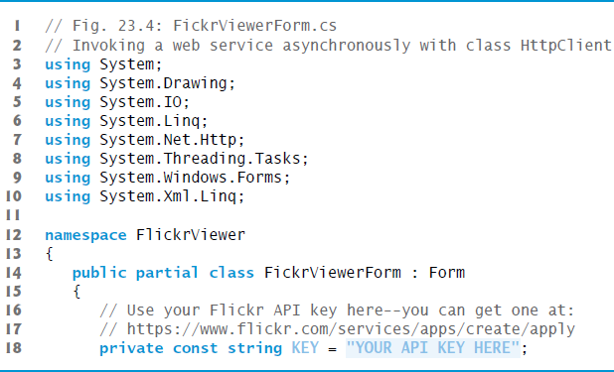
Figure 23.4 Invoking a Web Service Asynchronously with Class HttpClient (1 of 9)
©Paul Deitel.

Slide 30
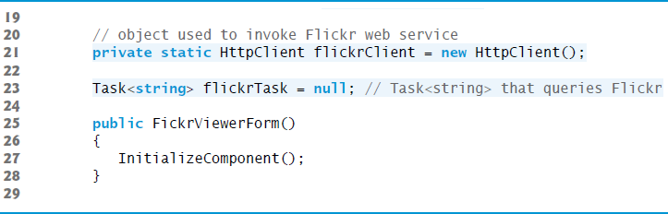
Figure 23.4 Invoking a Web Service Asynchronously with Class HttpClient (2 of 9)
©Paul Deitel.

Slide 31
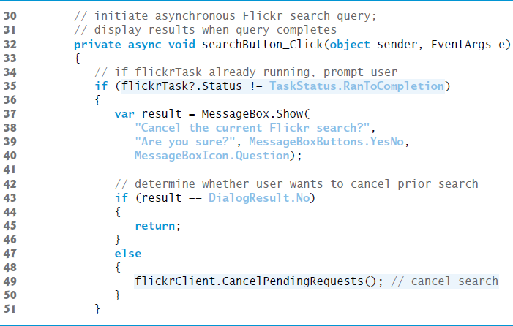
Figure 23.4 Invoking a Web Service Asynchronously with Class HttpClient (3 of 9)
©Paul Deitel.

Slide 32
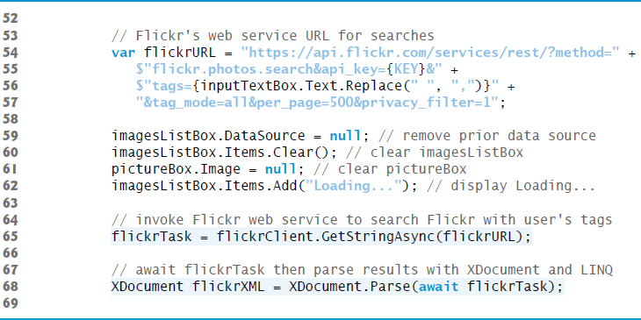
Figure 23.4 Invoking a Web Service Asynchronously with Class HttpClient (4 of 9)
©Paul Deitel.

Slide 33
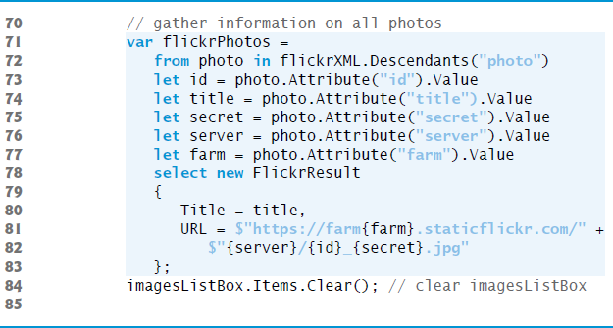
Figure 23.4 Invoking a Web Service Asynchronously with Class HttpClient (5 of 9)
©Paul Deitel.

Slide 34
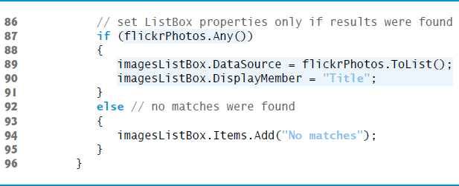
Figure 23.4 Invoking a Web Service Asynchronously with Class HttpClient (6 of 9)
©Paul Deitel.

Slide 35
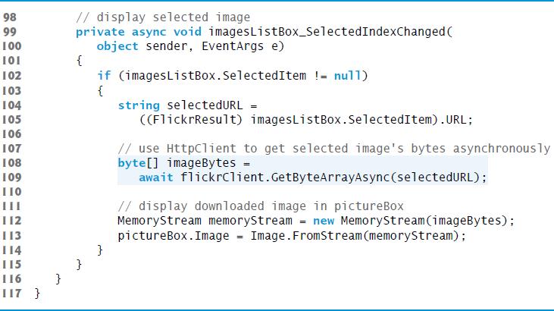
Figure 23.4 Invoking a Web Service Asynchronously with Class HttpClient (7 of 9)
©Paul Deitel.

Slide 36
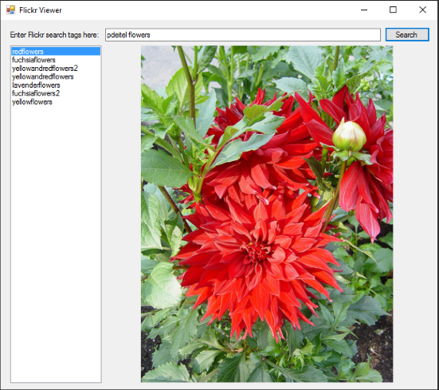
Figure 23.4 Invoking a Web Service Asynchronously with Class HttpClient (8 of 9)
©Paul Deitel.

Slide 37
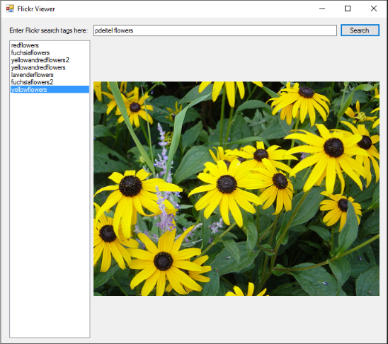
Figure 23.4 Invoking a Web Service Asynchronously with Class HttpClient (9 of 9)
©Paul Deitel.

Slide 38
Software Engineering Observation 23.2
An H t t p Client object is typically declared static so it can be used by all of an app’s threads. According to the H t t p Client documentation, a static H t t p Client object can be used from multiple threads of execution.

Slide 39
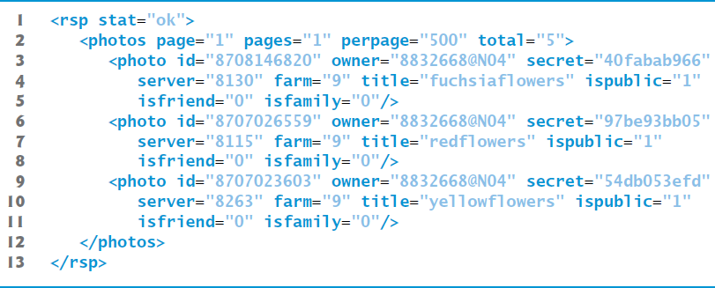
Figure 23.5 Sample X M L Response from the Flickr A P I s

Slide 40
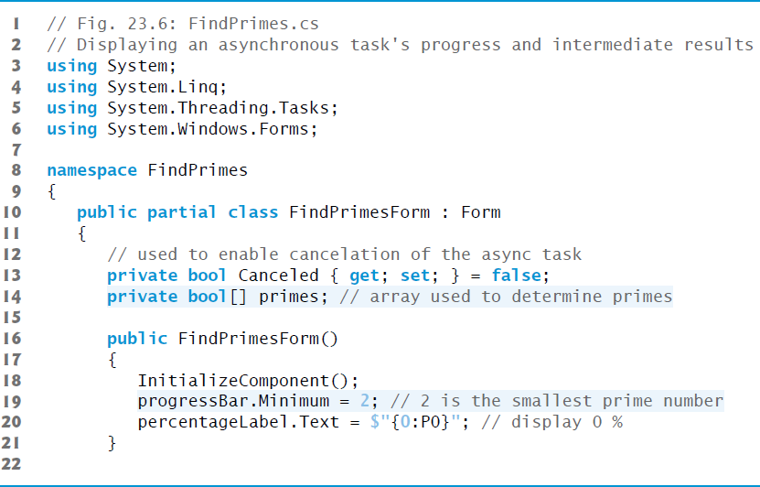
Figure 23.6 Displaying an Asynchronous Task’s Progress and Intermediate Results (1 of 7)

Slide 41
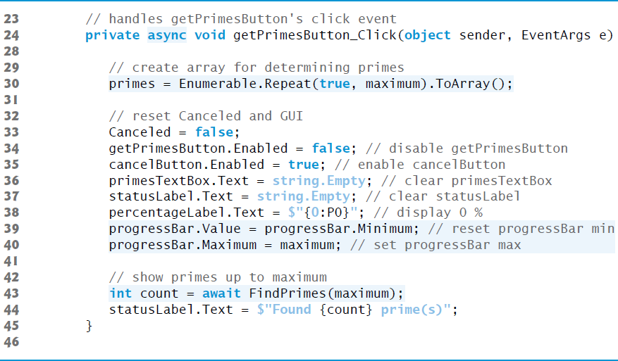
Figure 23.6 Displaying an Asynchronous Task’s Progress and Intermediate Results (2 of 7)

Slide 42
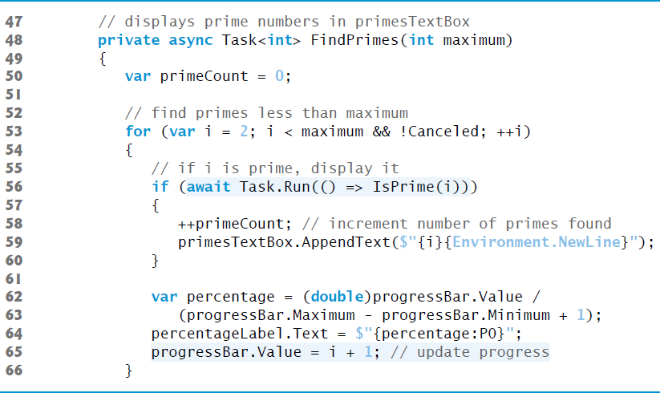
Figure 23.6 Displaying an Asynchronous Task’s Progress and Intermediate Results (3 of 7)

Slide 43
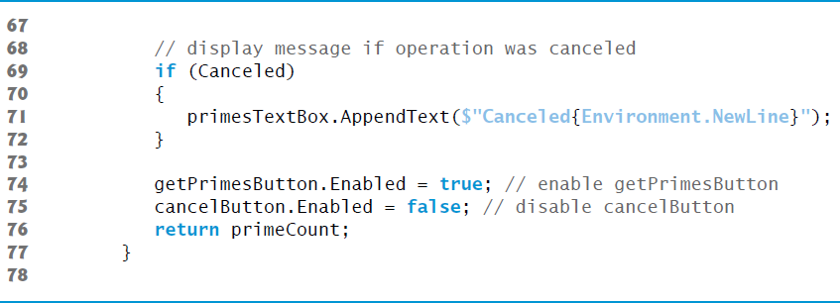
Figure 23.6 Displaying an Asynchronous Task’s Progress and Intermediate Results (4 of 7)

Slide 44
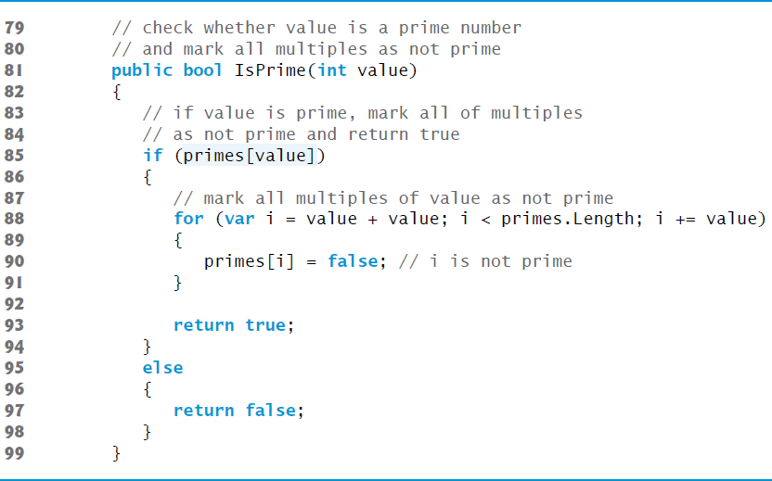
Figure 23.6 Displaying an Asynchronous Task’s Progress and Intermediate Results (5 of 7)

Slide 45
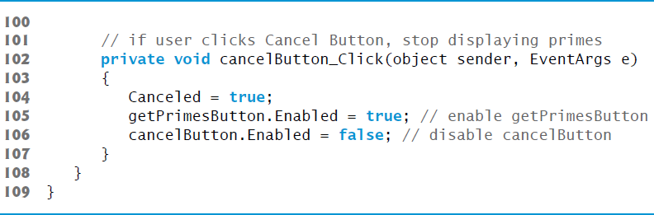
Figure 23.6 Displaying an Asynchronous Task’s Progress and Intermediate Results (6 of 7)

Slide 46
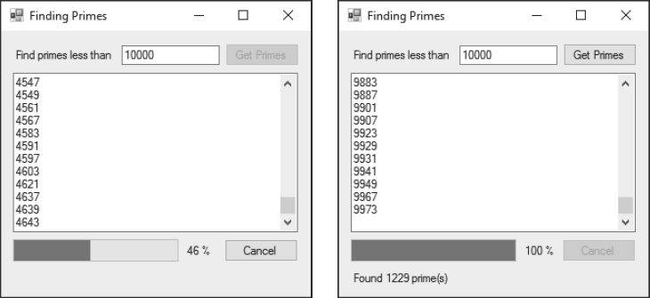
Figure 23.6 Displaying an Asynchronous Task’s Progress and Intermediate Results (7 of 7)

Slide 47

Copyright

